Slide 1

INFO310 Final Presentation
Group 6: Brandin Bulicki & Harsh Sharma
DIVOC

Slide 2
Agenda
DIVOC
Problem Space
Our Solution
Design Process
User Needs Analysis
Design Requirements
Affinity Diagram
Prototyping
Low-Fidelity Prototype
High-Fidelity Prototype
Revised High-Fidelity Prototype
User Testing
Final Design
Analysis of Design
Design Improvements
References

Slide 3
Problem Space
DIVOC
Based the recent events occurring from the coronavirus outbreak, many Americans have been forced from their normal lives into one of isolation and social distancing. In many cases, these events have caused those affected to struggle to find factual information, maintain social communication, practice healthy living, and support relief efforts, among other things. In extreme conditions, data reports increased suicide cases as a result of the isolation which results in countless number of lives lost apart from the coronavirus pandemic. Unfortunately, due to the rapid spread of this virus, few solutions exist at this time and no environment tackles all of the issues, mentioned above, that Americans face during these times of trouble.

Slide 4
Our Solution
DIVOC
Due to the number of lives being lost, it becomes of the utmost importance to approach this issue and attempt to solve the problems by providing the societal community with information for such resources in order to sustain during this outbreak period. Additionally, since the coronavirus spreads through social contact, the system aims to provide users with resources that can sustain their social lives by substituting physical contact for virtual contact. With the Disaster avoidance Initiative through Virtual Objective Communication (DIVOC) app, those affected from the pandemic will be able to maintain a sense of normalcy in these uncertain times

Slide 5
Design Process
DIVOC
Throughout the development of the DIVOC application, our group followed the design process that was structured specifically for the course. Following closely to the guidelines, we included our proposed end-user in multiple stages of the design process.

Slide 6
Design Process: User Needs
DIVOC
To obtain understanding of user needs, the research team conducted virtual interviews and obtained questionnaire results. Prospective participants were contacted and were given an overview of what would be required of them. An online consent form was then emailed to each willing participant. Upon completion of the consent form, participants were assigned a unique id and split into interview subjects (I0##) and questionnaire subjects (Q0##) ensuring that there was a variety in backgrounds in each grouping.
Participants were of various backgrounds, including age, sex, location of residence, and occupation. In total, fifteen participants partook in the study.
Participants for this study were chosen to meet the planned use case of persons aged 18 to 50. The intended environment for use of this application is within the United States, the participants were of those residing within the United States. While the uses of the general public are the primary function of DIVOC application, in order to account for both the general public and essential worker uses, representation for each party was selected accordingly.

Slide 7
Design Process: Design Requirements
DIVOC
An affinity diagram was able to be composed from the responses to interview and questionnaire data collects. From this diagram several themes emerged that were able to be used to determine the requirements the end users would primarily focus.
After completion of the diagram, the team was able to highlight the uses which were of most interest to the participants. At the most basic level, participants believed that the app should allow for the user to create a sense of normalcy during these unprecedented times. A majority of the participants noted that the most frustrating challenges currently faced include difficulty of communicating with others, finding accurate and trustworthy information, and maintaining a healthy lifestyle.

Slide 8
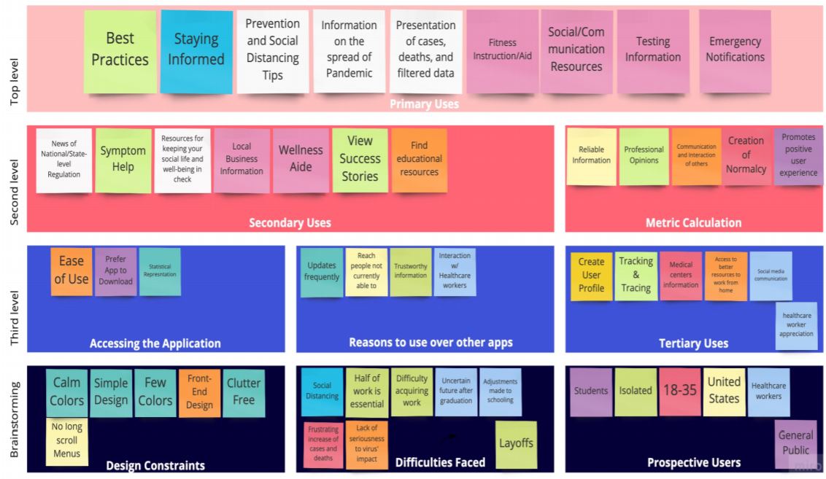
Design Process: Affinity Diagram
DIVOC

Slide 9
Design Process: Prototyping
DIVOC
From the composed design requirements, a prototype was created. In creating a prototype, to ensure that the design was meeting the needs of our users, the team first sketched a low-fidelity prototype. After analyzing our prototype and annotating the intended features and how each feature would fulfil a design requirement, we moved to form a high-fidelity prototype. Using Balsamic, a high-fidelity, semi-functioning prototype was created. This was presented to the class and received feedback. The feedback, in turn, allowed us to adjust in a rapid prototyping response.

Slide 10
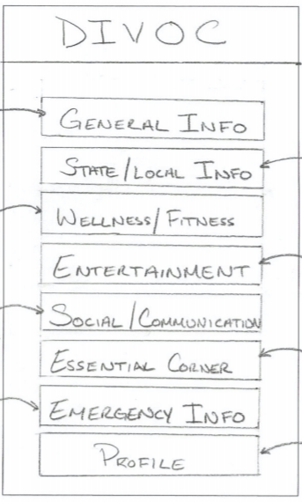
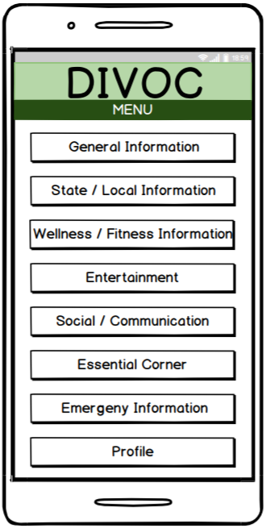
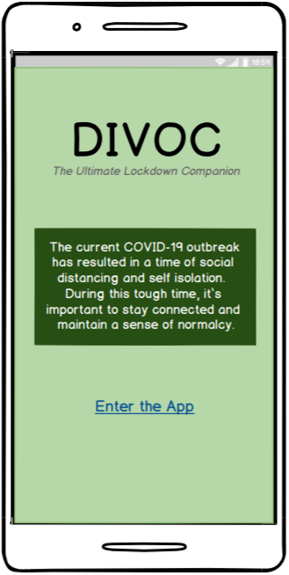
DIVOC
Design Process: Prototyping
Low-Fidelity
High-Fidelity
Revised

Slide 11
Design Process: User Testing
To gain a better understanding of whether the design requirements from our initial research were met in the DIVOC prototype, user testing was conducted. Methods of online testing and virtual face-to-face testing were used to obtain this data. Testing was conducted in similar manners to maintain consistency across both forms of tests.
Online testing was conducted via usertesting.com. Three participants selected at random were chosen to review the DIVOC prototype. Each participant reviewed the application following the tasks set forth. Responses were vocalized and their interactions were recorded in a screen recording of their session.
Face-to-face testing was conducted via video calls. Three participants were chosen to review the DIVOC prototype. Again, each participant reviewed the application following the tasks set forth. Unlike the online testing, users were given the tasks directly from the team member conducting the interview. Responses were vocalized and their interactions were seen on a shared screen element of their session.

Slide 12
Design Process: User Testing (cont.)
Participants were of various backgrounds, including age, sex, location of residence, and occupation. In total, six participants partook in the study. To gain an understanding of how the prototype meets the original requirements, set in GDP2, we included multiple participants from that study as testers.
Participants for this study were chosen to meet the planned use case of persons aged 18 to 50 residing within the United States.
The intended environment for use of this application is within the United States, the participants were of those residing within the United States. For that reason, participants were from a variety of areas in the country. These participants are in a variety of fields including full-time students, electricians, and product management.
While the uses of the general public are the primary function of DIVOC application, in order to account for both the general public and essential worker uses, representation for each party was selected accordingly.

Slide 13

Final Design
DIVOC
Notes:
Open up Final Prototype

Slide 14
Final Design: Analysis of Design
DIVOC
Visibility
Users options are clearly depicted and are easy to use.
Feedback
Every action has a reaction (ie. notification of success when signing up for alerts)
Affordance
Clear relationship of what something looks like and how it is used (ie. chatroom tabs)
Mapping
The controls to something closely resemble the effect. (ie. the controls to send a message)
Constraints
Limits to an interaction. (ie. navigating from one screen to another through the menu screen)
Consistency
The same action causes the same reaction every time. (ie. using the menu button)

Slide 15
Final Design: Design Improvements
DIVOC
Adjusted the titles of any misinterpreted label to ensure that each screen can be understood appropriately.
Reworked the landing page to ensure that the user can understand what the application is used for prior to delving into it for themselves.
Labeled the menu/back button to make its use more noticeable.
Examined the expected features on each screen of the prototype. Determined if there are any elements that can be added to any one screen.
Analyzed where the testers found data to be better represented in other forms. Determined whether there is a more preferred way to display the data.
Discussed the design elements currently used and analyze the feedback received. Determined if there is a better way to present the application. Reformatted accordingly.

Slide 16
References
DIVOC
Apple. “‎Apple COVID-19.” App Store, 26 Mar. 2020, apps.apple.com/us/app/id1504132184.
ArcGIS Dashboards, gisanddata.maps.arcgis.com/apps/opsdashboard/index.html#/bda7594740fd40299423467b48e9ecf6.
Brandom, Russell. “Answering the 12 Biggest Question About Apple and Google's New Coronavirus Tracking Project.” Theverge.com, 11 Apr. 2020, www.theverge.com/2020/4/10/21216484/google-apple-coronavirus-contract-tracing-bluetooth-location-tracking-data-app.
“Contact Tracing Bluetooth Specification.PDF,” 11 Apr. 2020.
“Coronavirus Resource Center.” Johns Hopkins Coronavirus Resource Center, 2020, coronavirus.jhu.edu/.
“COVID-19.” Apple Inc, www.apple.com/covid19/.
“Overview of COVID 19 Contact Tracing Using BLE.PDF” 10 Apr. 2020.

